Slide 1
COS 212 Binary Trees: Balancing a Tree

Slide 2
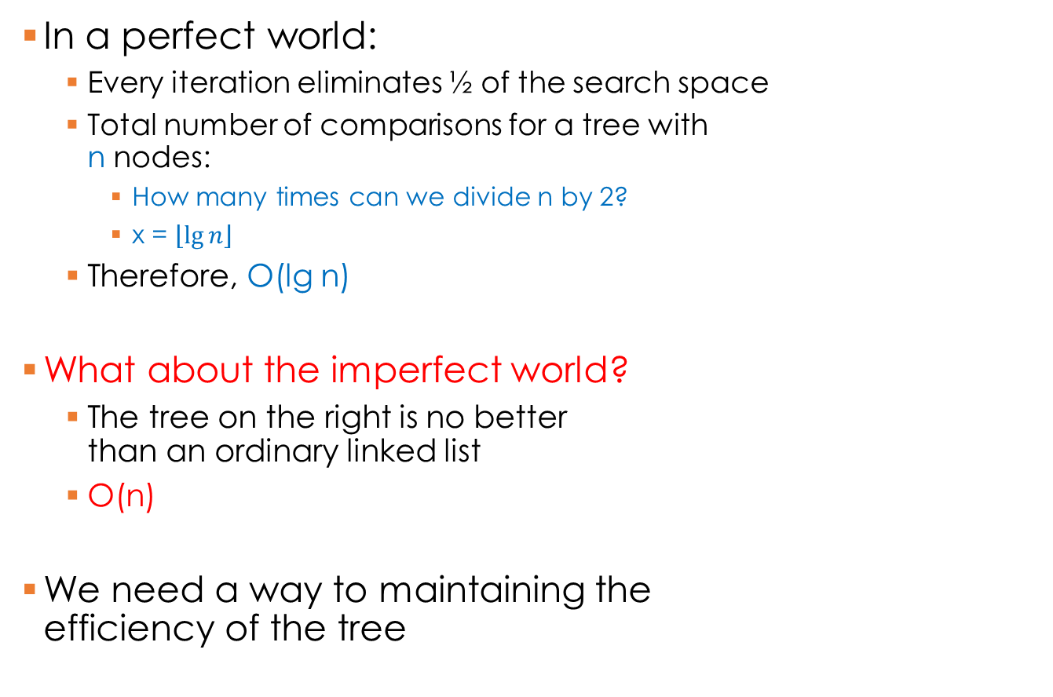
Binary Search Trees
5
In a perfect world:
Every iteration eliminates ½ of the search space
Total number of comparisons for a tree with n nodes:
How many times can we divide n by 2?
x = $\left\lfloor \lg{n}\right\rfloor$
Therefore, O(lg n)
What about the imperfect world?
The tree on the right is no better than an ordinary linked list
O(n)
We need a way to maintaining the efficiency of the tree
3
7
1
6
9
A
D
E
F
Z

Slide 3
Binary Search Trees
What makes a tree efficient?
We want to eliminate about ½ of the search space every time we go down a branch
Thus, the height of left and right branches of all nodes should be more or less the same height
Allow max difference between branch height = 1
A
3
D
5
1
7
E
10
3
7
2
6
F
5
1
6
9
Z

Slide 4
Balanced Binary Search Trees
A BST is height-balanced if the difference in height of both sub-trees of all nodes is either zero or one
A BST is perfectly balanced if it is balanced and all leaves are on one, max two levels
M
A
5
G
P
D
3
7
C
H
O
Q
E
1
6
9
B
D
J
N
F
A
Z

Slide 5
Balanced Binary Search Trees
How do we balance a tree?
Order of insertion matters:
A D E F Z
E A D F Z
A
E
D
A
F
E
D
Z
F
Z

Slide 6
Balanced Binary Search Trees
Sort the data
Find the middle
Insert the middle element
Repeat (2) on the left half
Repeat (2) on the right half
Problem?
An external data structure is necessary
Sorting is necessary
Must we do this every time an item is inserted?
E
A
F
D
Z

Slide 7
DSW Algorithm
Day–Stout–Warren (DSW) algorithm: a method for efficiently balancing BSTs without an additional data structure
What it does: converts an arbitrary BST into a perfectly balanced BST
How: by a series of tree rotations
What is a tree rotation?

Slide 8
Rotations
A single rotation swaps the roles of a child node and a parent node without breaking the BST relationship
Two types of rotations:
Left rotation: parent becomes the left child of its right child (i.e., parent moves to the left)
Right rotation: parent becomes the right child of its left child (i.e., parent moves to the right)
D
Right rotation of child A about parent D
A
E
E
A
Left rotation of child E about parent D
D
D
A
E

Slide 9
Rotations
G
?
What if the child nodes rotated are not leaf nodes?
Right rotation algorithm:
Parent becomes right child of its left child
Left child’s right branch becomes the old parent’s left branch (Example: C < D < G: D can be right of C or left of G )
C
H
B
D
J
C
G
B
G
C
H
D
H
B
D
J
J

Slide 10
Right Rotation: Step-by-step
Note: These are not values!
G = Grandparent
P = Parent
C = Child
G
G
G
P
P
P
C
C
C
Z
Z
Z
X
Y
X
Y
X
Y
1. Grandparent G of child C becomes C’s parent by replacing P
2. Right subtree of C becomes left subtree of C’s parent P
G
G
P
C
C
==
X
P
Z
X
Y
Y
Z
3. Node C acquires P as its right child

Slide 11
Left Rotation
Simply the opposite of a right rotation
Right rotation algorithm:
Parent becomes right child of its left child
Left child’s right branch becomes parent’s left branch
Left rotation algorithm:
Parent becomes left child of its right child
Right child’s left branch becomes parent’s right branch

Slide 12
Left Rotation
Note:
G = Grandparent
P = Parent
C = Child
These are not values!
G
G
P
C
C
P
X
Z
Y
Z
X
Y
C
G
Rotate Left around C
B
G
C
H
D
H
B
D

Slide 13
DSW Algorithm
Day–Stout–Warren (DSW) algorithm: a method for efficiently balancing BSTs without an additional data structure
Basic idea:
Linearize the tree into a single right branch, or backbone
Perform a series of left rotations on the linearized tree to make it perfectly balanced
Creating a backbone:
createBackbone()
tmp = root;
while tmp ≠ null
if tmp has a left child
right rotate this child about tmp;// left child becomes
right rotate this child about all;// parent of tmp;
set tmp to the child which just became parent;
else set tmp to its right child;

Slide 14
Creating a backbone
10
5
5
5
15
10
10
20
15
15
16
30
20
16
17
16
30
20
18
17
17
30
18
18

Slide 15
Creating a backbone
5
5
5
10
10
10
15
15
15
16
16
16
20
17
17
17
30
20
18
18
18
30
20
30

Slide 16
DSW Algorithm
Now that we have a backbone:
We need to convert the backbone into a perfectly balanced tree
Remember, a perfectly balanced tree
Is height balanced
Has leaf nodes on a maximum of two levels
To do this, we need to figure out how many left rotations are required
Left rotations are based on
The number of nodes in the backbone
The number of nodes making up a full tree of the required size
Possibly some “overflow” nodes

Slide 17

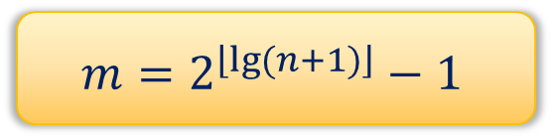






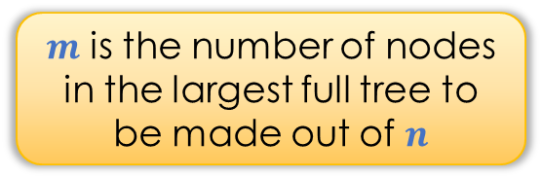
DSW Algorithm
Start with a backbone
The backbone has $n$ nodes
How many levels will a resulting perfectly balanced tree have?
$n=2^{h}−1$
$2^{h}=n+1$
$h=lg⁡(n+1)$
Assumption: $n$ “fills” a perfect tree
What if n = 8?
Level: 1, # nodes: $2^{0}$ = 1
Tree height $h=3$
Number of nodes?
7
= $2^{3} −1$
Level: 2, # nodes: $2^{1}$ = 2
Given $n$, what is $h$?
Level: 3, # nodes: $2^{2}$ = 4
$$m=2^{\left\lfloor lg(n+1)\right\rfloor }−1$$
$m$ is the number of nodes in the largest full tree to be made out of $n$

Slide 18
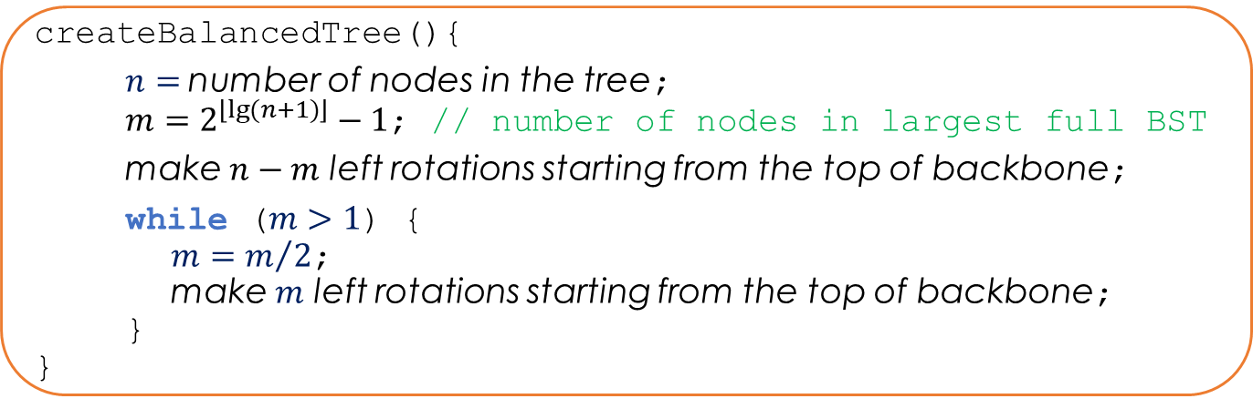
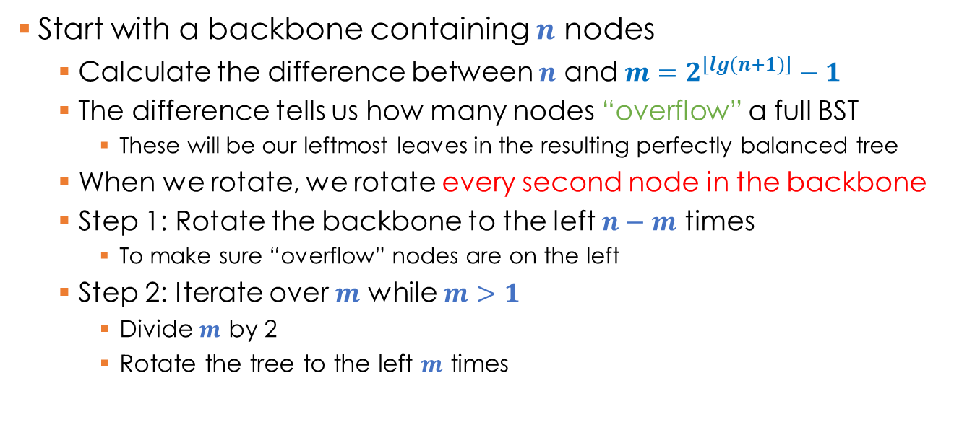
DSW Algorithm
Start with a backbone containing $n$ nodes
Calculate the difference between $n$ and $m=2^{\left\lfloor lg(n+1)\right\rfloor }−1$
The difference tells us how many nodes “overflow” a full BST
These will be our leftmost leaves in the resulting perfectly balanced tree
When we rotate, we rotate every second node in the backbone
Step 1: Rotate the backbone to the left $n−m$ times
To make sure “overflow” nodes are on the left
Step 2: Iterate over $m$ while $m>1$
Divide $m$ by 2
Rotate the tree to the left $m$ times
createBalancedTree(){
$n=$number of nodes in the tree;
$m=2^{\left\lfloor lg(n+1)\right\rfloor }−1$; // number of nodes in largest full BST
make $n−m$ left rotations starting from the top of backbone;
while ($m>1$) {
$m=m/2$;
make $m$ left rotations starting from the top of backbone;
}
}

Slide 19
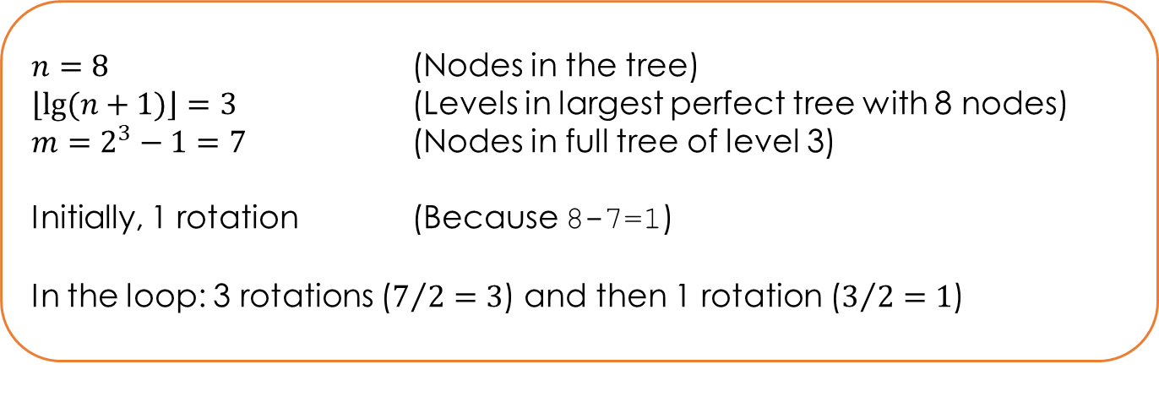

DSW Algorithm
createBalancedTree(){
$n=$number of nodes in the tree;
$m=2^{\left\lfloor lg(n+1)\right\rfloor }−1$; // number of nodes in largest full BST
make $n−m$ left rotations starting from the top of backbone;
while ($m>1$) {
$m=m/2$;
make $m$ left rotations starting from the top of backbone;
}
}
$n=8$ (Nodes in the tree)
$\left\lfloor lg(n+1)\right\rfloor =3$ (Levels in largest perfect tree with 8 nodes)
$m=2^{3}−1=7$ (Nodes in full tree of level 3)
Initially, 1 rotation (Because 8-7=1)
In the loop: 3 rotations ($7/2=3$) and then 1 rotation ($3/2=1$)

Slide 20
DSW Algorithm: Creating Balanced BST
5
10
15
10
5
15
10
17
15
16
5
16
20
16
17
18
30
17
18
17
18
20
15
20
20
30
10
16
18
30
30
5

Slide 21
AVL Trees
DSW is a good algorithm to balance an unbalanced tree
Disadvantage?
What happens if we insert or delete a node?
DSW works on the global tree structure
We need an algorithm to adjust the tree locally when an item is added or removed such that the balance is maintained
AVL trees
Invented in 1962 by two Soviet scientists: Georgy Adelson-Velsky and Evgenii Landis
The sub-trees of every node differ in height by at most one
Every sub-tree is an AVL tree
3
E
G
1
7
A
F
C
H
2
6
10
B
D
D
Z
5

Slide 22
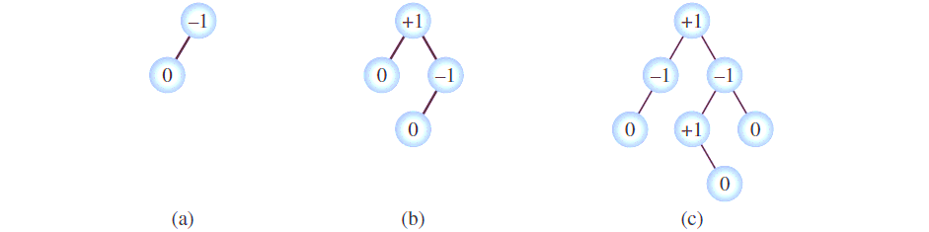
AVL Trees
AVL tree properties
The sub-trees of every node differ in height by at most one
Every sub-tree is an AVL tree
When an item is inserted or deleted, the above two properties must be preserved
How: every node has a “balance factor”: a number that indicates the difference between the height of the right and the left branch (bf = h(right) – h(left))
In a valid AVL tree, every node has a balance factor of -1, 0, or +1
When an item is inserted/deleted, the balance factors are updated, and if the balance is lost, the tree is rebalanced

Slide 23
AVL Trees: Insertion
How can a tree get out of balance?
Can a tree get out of balance if its left and right branches are of the same height?
Can a tree get out of balance if the left branch is longer than the right branch?
If the right branch is longer than the left branch?
G
C
H
G
G
C
H
C
I
B
D
H
J

Slide 24
AVL Trees: Insertion
If an insertion doesn’t unbalance the tree
Rebalancing is not required
We only need to update the balance factors for nodes moving back from the inserted node towards the root of the AVL tree
For example
-1
G
0
G
0
C
H
0
0
C
H
1
0
B
D
0
0
B
D
0
I
0

Slide 25
AVL Trees: Insertion
But, if an insertion unbalances the tree
We need to update the balance factors for nodes moving back from the inserted node towards the root of the AVL tree
We also need to rebalance the tree

Slide 26
AVL Trees: Insertion
Cases 1 & 4 mirror each other
Cases 2 & 3 mirror each other
Four cases producing an unbalanced tree:
Insert into the left subtree of the left child of n
Insert into the right subtree of the left child of n
Insert into the left subtree of the right child of n
Insert into the right subtree of the right child of n
1
3
G
2
C
4
G
C
C
H
B
I
C
H
B
I
B
D
H
J
B
D
H
J
A
D
E
Z

Slide 27
AVL Trees: Insertion
Let’s consider the two basic cases:
Insert into the left subtree of the left child of n (inserting on the “outside”)
Insert into the right subtree of the left child of n (inserting on the “inside”)
1
2
G
G
C
H
C
H
B
D
B
D
A
E

Slide 28
AVL Trees: Insertion
Case 1: Insert into the left subtree of the left child of n
Rebalance tree: One right rotation about unbalanced node
-2
G
0
C
-1
C
H
Rotate C around G
-1
B
G
0
-1
B
D
0
A
D
H
0
A

Slide 29
AVL Trees: Insertion
Case 2: Insert into the right subtree of the left child of n
Rebalance tree: One right rotation about unbalanced node?
-2
G
C
1
C
H
Rotate C around G
B
G
B
D
1
D
H
☹
E
0
E

Slide 30
AVL Trees: Insertion
Case 2:
First, transform Case 2 into Case 1 (left rotation about the left child)
Now, rebalance tree by a right rotation about unbalanced node!
We performed a left rotation first, then a right rotation
Sometimes, this AVL operation is referred to as a double rotation
Rotate D around C
Rotate D around G
-2
G
-2
G
0
D
1
C
H
-1
D
H
-1
C
G
0
B
D
1
-1
C
E
0
B
E
H
0
E
0
B

Slide 31
AVL Trees: Insertion
Four cases:
Right rotation about n
Left rotation about n.left, then right rotation about n
Right rotation about n.right, then left rotation about n
Left rotation about n
1
3
G
2
C
4
G
C
C
H
B
I
C
H
B
I
B
D
H
J
B
D
H
J
A
D
E
Z

Slide 32
AVL Trees: Insertion
How are we going to code it?
Starting from the node at which an insert happened, backtrack towards the root, updating the balance factors
If a balance factor > 1 or < -1 is encountered for node n:
If negative: Left branch insert happened
Is the inserted value x > n.left?
TRUE: Insert in right sub-tree of left child
Do a double Left-Right rotation
FALSE: Insert in left sub-tree of left child
Do a single Right rotation
If positive: Right branch insert happened
Is the inserted value x < n.right?
TRUE: Insert in left sub-tree of right child
Do a double Right-Left rotation
FALSE: Insert in right sub-tree of right child
Do a single Left rotation
Stop after the first unbalanced node has been found
Note that no ancestor nodes of n need
to have their balance factors updated
3
-2
1
9
-1
2
6
10
?
-1
5
7
0
4

Slide 33
AVL Trees: Deletion
To delete a node from AVL tree, perform delete by copying
Replace the node with the rightmost node of its left subtree
Update balance factors
Start with the original parent of copied node and move to the root
In the example:
We are deleting node 3
Replace node 3 with node 2
Delete node 2
Update balance factors from the original parent of the deleted node (node 1) up to the root
What if the tree becomes unbalanced?
For every unbalanced node encountered on the path to the root, re-balance the tree using rotations
Several re-balancing operations may therefore be necessary, unlike for insertions
How do we know what rotations are needed?
Specific combination of the corresponding balance factors will give us a good idea
?
2
3
0
1
9
2
6
10
5
7

Slide 34
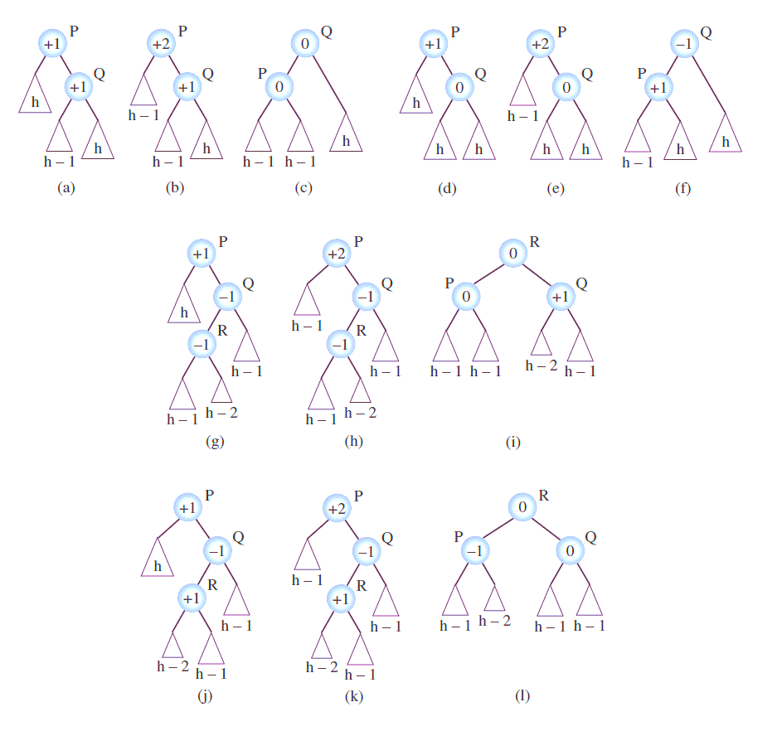
AVL Trees: Deletion
Case 1: Delete in the left branch causes left branch to become too small, and the right branch has +1 balance
One left rotation about unbalanced node re-balances tree:
1
C
2
C
0
D
B
D
1
D
1
C
E
0
E
E

Slide 35
AVL Trees: Deletion
Case 2: Delete in the left branch causes left branch to become too small, and the right branch has 0 balance
One left rotation about unbalanced node re-balances tree:
1
C
2
C
-1
E
B
E
0
E
0
1
C
F
D
F
D
F
D

Slide 36
AVL Trees: Deletion
Case 3: Delete in the left branch causes left branch to become too small, the right branch has -1 balance, and the left child of the right child also has -1 balance.
A double rotation is required:
Right rotation about right child of unbalanced node
Left rotation about unbalanced node
1
3
2
3
2
3
6
0
-1
-1
1
9
2
9
2
6
1
0
3
9
1
-1
-1
1
2
6
10
6
10
5
9
2
5
10
5
5
10

Slide 37
AVL Trees: Deletion
Case 4: Delete in the left branch causes left branch to become too small, the right branch has -1 balance, and the left child of the right child also has +1 balance.
A double rotation is required:
Right rotation about right child of unbalanced node
Left rotation about unbalanced node
1
3
2
3
2
3
6
0
-1
-1
1
9
2
9
2
6
2
-1
3
9
0
1
1
0
2
6
10
6
10
9
2
7
10
7
7
7
10

Slide 38
AVL Trees: Deletion
Cases 1 & 2 (root +2, right >= 0) require the same single rotation – do with a single if statement
Cases 3 & 4 (root +2, right < 0) require the same double rotation – do with a single if statement
Four more cases if the right branch becomes too short: mirror the 4 cases discussed
8 distinct cases to consider in total
Try it out as an exercise!

